Slide 1
Peer-to-peer network analysis
By Qassem Al-Hanbali

Slide 2
Peer-to-peer network
A peer-to-peer (P2P) network is group of computers, each of which acts as a node for sharing files within the group. Instead of having a central server to act as a shared drive, each computer acts as the server for the files stored upon it.

Slide 3
Dataset
Dataset information
A sequence of snapshots of the Gnutella peer-to-peer file sharing network from August 2002. There are total of 9 snapshots of Gnutella network collected in August 2002. Nodes represent hosts in the Gnutella network topology and edges represent connections between the Gnutella hosts.
The dataset consists of 6301 nodes and 20777 edges.
Notes:
https://snap.stanford.edu/data/p2p-Gnutella08.html

Slide 4
Using networkx for analysis
NetworkX is a package for the Python programming language that's used to create, manipulate, and study the structure, dynamics, and functions of complex graph networks.
In this project we used NetworkX to do some calculations such as betweenness centrality, degree centrality, closeness centrality, clustering coefficient and more.
We also used NetworkX for creating network Graphs.

Slide 5

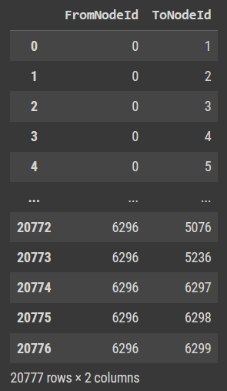
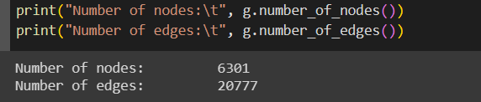
Coding
For more detailed codes, you can check the Jupyter notebook or the google-colab link: https://colab.research.google.com/drive/1cZ_UXmjAeiUWVlTi6BkDPIcV9NedhIAN?usp=sharing

Slide 6
Thank You

